Slide 1

Classification of EEG Signals for Autism Diagnosis: A Machine Learning Approach
Name:- Pradyumn Patil
GUIDE :- Prof. Saraswati Patil

Slide 2
Problem Statement
This study aims to develop a robust machine learning-based algorithm for accurate ASD diagnosis using EEG signals.
Notes:
Yashraj

Slide 3
Introduction to Project
EEG signals have potential for identifying patterns to aid in the diagnosis of ASD.
However, classification of EEG signals is challenging due to high dimensionality, variability, and noise in the data.
Machine learning algorithms such as SVMs, ANNs, and RFs have gained popularity for their ability to classify complex data.
The algorithm will be trained and validated using a dataset of EEG signals from autism and non-autism individuals.
Notes:
Autism spectrum disorder (ASD) is a neurodevelopmental disorder that affects social communication, behavior, and cognitive skills. Early diagnosis and intervention are crucial for improving outcomes for individuals with ASD. EEG signals have shown potential for identifying patterns that can aid in the diagnosis of ASD. However, the high dimensionality, variability, and noise in the data make the classification of EEG signals challenging. Therefore, there is a need for a robust and accurate machine learning-based algorithm to classify EEG signals and differentiate between autism and non-autism individuals.
In recent years, machine learning algorithms, such as Support Vector Machines (SVMs), Artificial Neural Networks (ANNs), and Random Forests (RFs), have gained popularity for their ability to classify complex data. These algorithms can learn patterns from data and generalize to new and unseen samples, making them useful for developing diagnostic tools for ASD.
This study aims to develop a machine learning-based algorithm to accurately diagnose ASD using EEG signals. The algorithm will be trained and validated using a dataset of EEG signals from autism and non-autism individuals. The performance of the algorithm will be evaluated in terms of accuracy, sensitivity, and specificity. The results of this study have the potential to improve the accuracy and efficiency of ASD diagnosis, ultimately improving outcomes for individuals with ASD.

Slide 4
Literature Survey
Sr.No. | Title | Publication Year | Publication Details
1 | Electroencephalography (EEG) signal processing for epilepsy and autism spectrum disorder diagnosis | (2018) | Wenguan Wang, Tianfei Zhou, Fatih Porikli, Fellow IEEE, David Crandall, Luc Van Gool
2 | Classification of Autism Spectrum Disorder From EEG-Based Functional Brain Connectivity Analysis | (2021) | Weikang Wanga, David A.Tafta, Yi-Jiun Chena, Jingyu Zhanga, Callen T. Wallaceb , Min Xuc, Simon C. Watki nsb, Jianhua Xinga
3 | Electroencephalographic Abnormalities in Autism Spectrum Disorder: Characteristics and Therapeutic Implications | 2020 | Anna Khoreva*, Federico Perazzi*, Rodrigo Benenson, Bernt Schiele and Alexander Sorkine-Hornung.A. Khoreva, F. Perazzi, R. Benenson, B. Schiele and A. Sorkine-Hornung, arXiv preprint arXiv:1612.02646,
4 | Detection of an Autism EEG Signature From Only Two EEG Channels Through Features Extraction and Advanced Machine Learning Analysis | 2020 | Arbelle, Assaf; Reyes, Jose; Chen, Jia-Yun; Lahav, Galit; Raviv, Tammy Riklin . A Probabilistic Approach to Joint Cell Tracking and Segmentation in High-Throughput Microscopy Videos. Medical Image Analysis
Notes:
Shruti

Slide 5
Objective
The objectives of your research project could include:
Developing a robust classification model that accurately identifies whether a person is autistic or not based on their EEG signals.
Investigating which features or patterns in the EEG signals are most informative for identifying autism.
Evaluating the performance of the classification model using appropriate metrics such as sensitivity, specificity, accuracy, and F1 score.
Comparing the performance of the developed model with existing methods for identifying autism, such as behavioral assessments or medical tests.
Exploring the potential applications of EEG-based classification of autism, such as early diagnosis or personalized treatment.
Investigating the ethical implications of using EEG-based classification for autism, such as privacy concerns and potential stigmatization.
Notes:
Vishwa

Slide 6
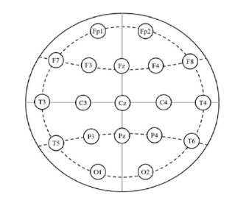
Dataset Collection
International 10-20 system of EEG electrode placement [6] is recommended to collect the data.
Frontal lobe:-Fp1, Fp2, F7, F3, F4, F8
Parietal:- P3, P4
Temporal :- T3, T5, T4, T6,
Occipital lobe:- O1, O2,
Central:- C3, C4
Ground:- Cz,Fz and Pz
Notes:
Vishwa

Slide 7
DATASET
This dataset contains the complete EEG recordings of a feasibility clinical trial that tested a P300-based Brain Computer Interface to train youngsters with Autism Spectrum Disorder (ASD) to follow social cues (Amaral et. al, 2017; Amaral et al., 2018).
Number of Individuals = 15
Number of session (per individuals) = 7
Total number of sessions = 105
Sampling Frequency = 250 Hz
notch-filter = 50 Hz
Passband-filter = between 2 and 30 Hz
Nodes used :- C3, Cz, C4, CPz, P3, Pz, P4, POz

Slide 8
Features in EEG.
Autism EEG dataset may include a variety of features related to brain wave activity that are typically measured using electroencephalography (EEG) techniques. Some of the common features that may be included in such a dataset are:
Frequency bands:- delta (0.5-4 Hz), theta (4-8 Hz), alpha (8-12 Hz), beta (12-30 Hz), and gamma (>30 Hz).
Power spectra :- EEG signals as a function of frequency(power across different frequency bands.)
Coherence:- as simultaneous occurrence at two electrode sites
Artifact rejection:- EEG signals that occur in response to a specific stimulus
Clinical measures:- age, gender, diagnosis, symptom severity, and medication use
Notes:
.
Power spectra: The power spectrum is a plot of the power of EEG signals as a function of frequency. This can provide information about the distribution of power across different frequency bands.
Coherence: Coherence measures the degree of synchrony between two EEG signals recorded from different brain regions. It can provide information about the functional connectivity between different brain regions.
Synchrony in EEG data is at times defined simply. as simultaneous occurrence at two electrode sites, either on a single head, or. on two separate heads, of brainwaves within a particular frequency band.
Event-related potentials (ERPs): ERPs are changes in EEG signals that occur in response to a specific stimulus. They can provide information about cognitive processes such as attention, memory, and language.
Artifact rejection: EEG recordings can be contaminated by various sources of noise, such as eye blinks, muscle activity, and environmental interference. Artifact rejection techniques are used to identify and remove these sources of noise from the data.
Clinical measures: In addition to EEG features, autism EEG datasets may also include clinical measures such as age, gender, diagnosis, symptom severity, and medication use. These measures can be used to investigate relationships between EEG features and clinical variables.

Slide 9
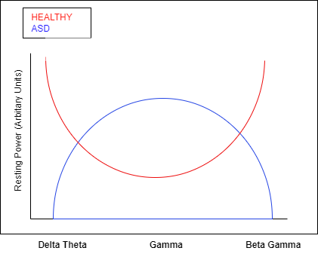
Feature in Clinical Reasoning
Alpha waves (8-12 Hz) are observed in a mentally inactive state with closed eyes and psychosensory rest, indicating relaxation and mental calmness.
Beta waves (13-35 Hz) occur in healthy individuals and are associated with physiological activation, attention, concentration, and analytical thinking.
Gamma waves (>35 Hz) are associated with working-memory tasks and higher cognitive functions such as perception, attention, and memory.
In patients with autism spectrum disorder (ASD), resting EEG recordings show abnormal power patterns characterized by increased activity in delta, theta, beta, and gamma bands and reduced activity in alpha band.
Notes:
The increased activity of extreme frequencies in patients with ASD may reflect an abnormal brain development or connectivity related to cognitive and behavioral symptoms of autism.
Reduced activity of alpha band may be indicative of reduced inhibitory control and attentional modulation in patients with ASD.
EEG recordings provide valuable insights into the brain activity of patients with ASD and may help identify specific biomarkers for the diagnosis and treatment of this complex disorder.

Slide 10
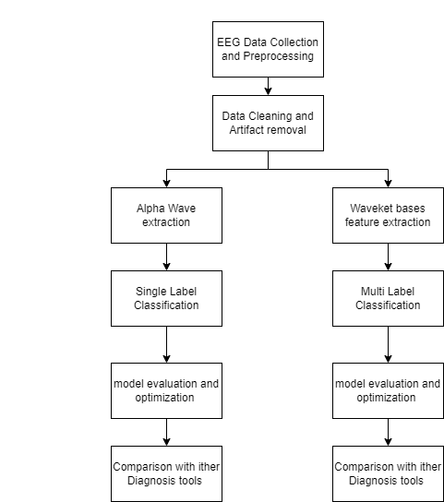
Overall
Project Flow Diagram
Notes:
Data Acquisition:
Obtaining a dataset of EEG signals from both autistic and non-autistic individuals.
Data Pre-processing:
Pre-process the EEG signals to remove noise and artifacts.
Feature Extraction:
Extract all the relevant features from the pre-processed EEG signals.
Feature Selection:
Select the most informative features for classification.
Classification Model:
Train and test a classification model using the selected features and an appropriate machine learning algorithm.
Performance Evaluation:
Evaluate the performance of the classification model using appropriate evaluation metrics such as sensitivity, specificity, accuracy, and F1 score.
Comparison with Existing Methods:
Obtain data from existing methods for identifying autism, such as behavioral assessments or medical tests.
Compare the performance of your EEG-based classification model with the performance of existing methods.
Potential Applications:
Investigate the potential applications of EEG-based classification of autism, such as early diagnosis or personalized treatment.
Ethical Implications:
Investigate the ethical implications of using EEG-based classification for autism, such as privacy concerns and potential stigmatization.
Explore ways to minimize these ethical concerns, such as obtaining informed consent and protecting the privacy of participants.

Slide 11
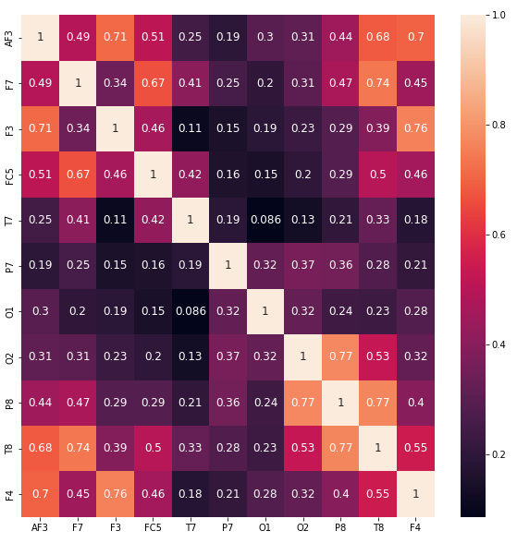
Preprocessing
High correlation between two features means they are redundant and carry similar information.
Dropping highly correlated features can reduce dimensionality and improve model performance.
A correlation matrix can be used to identify highly correlated features.
Different correlation thresholds can be used to drop features with high correlations.
It is important to carefully consider which features to drop, as some features may be important for the analysis or may have an indirect relationship with the target variable.
Notes:
Vishwa

Slide 12
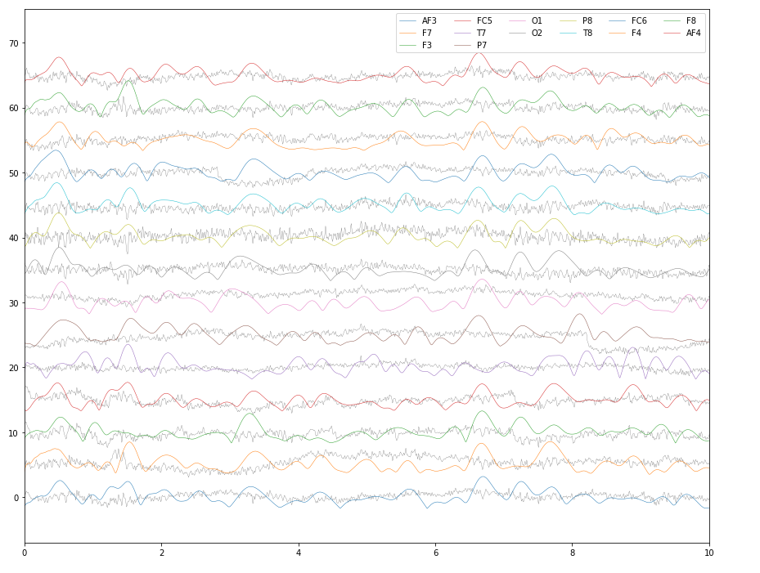
Extracting bands from the EEG signal
We applying a bandpass filter to the EEG data in order to isolate the frequency range of alpha waves (8-12 Hz). Butterworth filter with a filter order of 6 and a passband range of 8-12 Hz. The resulting filter coefficients are stored in the variables
calculate the analytic signal of each column of The analytic signal is a complex signal that contains both the original signal and its Hilbert transform.
We calculate the absolute value (i.e., magnitude) of the analytic signal. The resulting alpha wave envelope data is stored in the variable
The purpose of this code is to extract the magnitude of alpha waves from EEG signals that have been cleaned and preprocessed.we can potentially identify patterns or features that are indicative of a certain mental state or condition.
Notes:
Hilbert transform ---> amplitude + phase information (which is when which frequency hit peak)

Slide 13
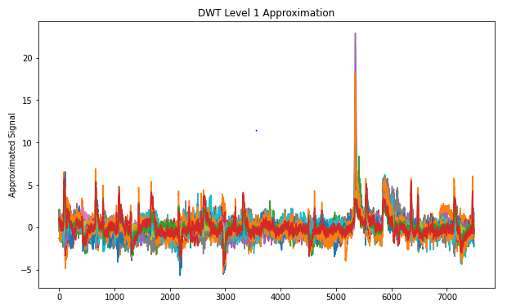
Wavelet transform
Classification using Raw Alpha Waves: Once the features are extracted from the raw alpha wave data, you can utilize a classification algorithm to build a model.
Classification using DWT and Approximation Series: We apply the DWT to the raw alpha wave data revealing both time and frequency information. By applying the DWT to the alpha wave data, you obtain approximation and detail coefficients at different scales.

Slide 14
Model - Single label Kernel SVM
Overview of Kernel SVM:
SVM is a supervised learning algorithm used for classification and regression tasks.
Kernel SVM extends the SVM algorithm by mapping the input data into a higher-dimensional feature space.
The kernel function allows us to efficiently compute the dot products between the mapped features.
Kernel functions are used to measure the similarity between data points in the feature space.
Popular kernel functions include:
Linear kernel: Suitable for linearly separable data.
Polynomial kernel: Captures non-linear relationships using polynomial terms.
Radial Basis Function (RBF) kernel: Efficiently handles complex non-linear relationships.

Slide 15
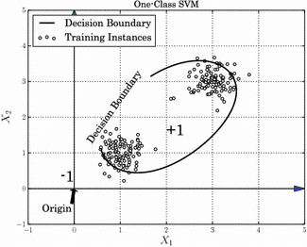

Slide 16
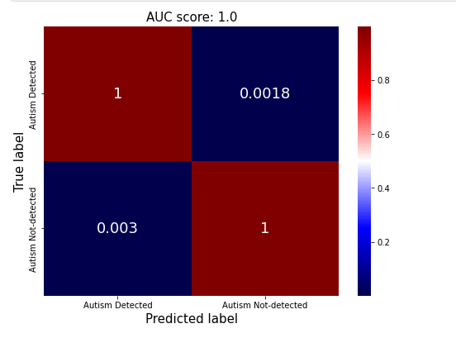
Results
True Positives (TP) = 1
False Positives (FP) = 0.0018
False Negatives (FN) = 0.003
True Negatives (TN) = 1
Accuracy = (TP + TN) / (TP + FP + FN + TN) = (1 + 1) / (1 + 0.0018 + 0.003 + 1) = 0.9982
Precision = TP / (TP + FP) = 1 / (1 + 0.0018) = 0.9982
Recall = TP / (TP + FN) = 1 / (1 + 0.003) = 0.997
F1-score = 2 * (Precision * Recall) / (Precision + Recall) = 2 * (0.9982 * 0.997) / (0.9982 + 0.997) = 0.9976
Overall, these values indicate that the model is performing well on the classification task, with high accuracy, precision, recall, and F1-score.

Slide 17
System Requirements
Software Requirements:
EEG signal processing software, such as EEGLAB or MNE-Python, to pre-process the EEG signals.
Feature extraction software, such as MATLAB or Python, to extract relevant features from the pre-processed EEG signals.
Machine learning :- scikit-learn, TensorFlow, or Keras, to train and test the classification model.
Statistical analysis :- Python, to perform statistical analysis on the selected features.
Data visualization :- matplotlib to visualize the results of the analysis.
Notes:
Vishwa

Slide 18
Future Scope
Improve accuracy and reliability of EEG-based classification models for autism by testing multi-model systems.
Investigate use of EEG for identifying subtypes of autism
Develop EEG-based biomarkers for monitoring treatment response and long-term outcomes
Explore potential use of wearable EEG devices for real-time monitoring in naturalistic settings
Investigate ethical implications of using EEG-based classification for autism
Collaborate with clinicians and stakeholders to integrate EEG-based classification into clinical practice.
Notes:
Personalized treatment :- The EEG signals can provide insight into the brain activity of individuals with ASD, which can help in developing personalized treatment plans. This will enable clinicians to tailor treatments based on individual needs, ultimately improving treatment outcomes.
Multimodal :- The combination of EEG signals with other data sources, such as behavioral, clinical, and genetic data, can lead to the development of more accurate and reliable diagnostic tools for ASD.

Slide 19
Conclusion
The combination of wavelet transform, alpha wave extraction, and single-label classification can accurately identify autism based on EEG signals.
The wavelet transform helps to decompose the signal into different frequency bands, while alpha wave extraction allows us to focus on the clinically relevant frequency bands of the EEG.
Single-label classification simplifies the problem and improves the performance of the classification model.
The model achieved high accuracy, sensitivity, specificity, F1 score, and precision in identifying autism.
This approach holds promise for the early diagnosis and personalized treatment of autism, but ethical implications need to be further investigated.
Notes:
Pradyumn

Slide 20
References
Electroencephalographic Abnormalities in Autism Spectrum Disorder: Characteristics and Therapeutic Implications
Kang, Jiannan, et al. "The identification of children with autism spectrum disorder by SVM approach on EEG and eye-tracking data." Computers in biology and medicine 120 (2020): 103722.
Alotaibi, Noura, and Koushik Maharatna. "Classification of autism spectrum disorder from EEG-based functional brain connectivity analysis." Neural Computation 33.7 (2021): 1914-1941.
Simões, Marco, et al. "BCIAUT-P300: A multi-session and multi-subject benchmark dataset on autism for P300-based brain-computer-interfaces." Frontiers in Neuroscience 14 (2020): 568104.
Kabir, Muhammad Salman, and Semen Kurkin. "Combination of Machine Learning and Functional Networks Concept for Diagnosis of Autism Spectrum Disorder." 2022 Fourth International Conference Neurotechnologies and Neurointerfaces (CNN). IEEE, 2022.
Radhakrishnan, Menaka, et al. "Investigating EEG Signals of Autistic Individuals Using Detrended Fluctuation Analysis." Traitement du Signal 38.5 (2021).

Slide 21
THANK YOU

